Slide 1
SOLAR ECG WITH CLOUD PLATFORM
BY
1.S.SIVASHANKAR
2.V.DANIEL
3. K. AJITH NARAYANAN
UG SCHOLAR
DEPARTMENT OF EEE
PANIMALAR INSTITUTE OF TECHNOLOGY

Slide 2
ABSTRACT
The cardiovascular (CV) crisis is glaringly evident in developed as well as in
developing countries.
An Electrocardiograph (ECG) is a device that diagnose and detects
heart abnormalities, which measures electrical potentials on the surface of the body
and creates a record (electrocardiogram) of the electrical currents associated with
heart muscle activity.
To reduce dependence on electricity, solar powered
ECG machines are introduced which has microchip that records patients details in it.
Cloud Storage is used to Store the data obtained from the microchip through Internet so that doctors from distant places can access the stored instantly and express their opinion

Slide 3


NEED FOR THIS PROJECT

Slide 4
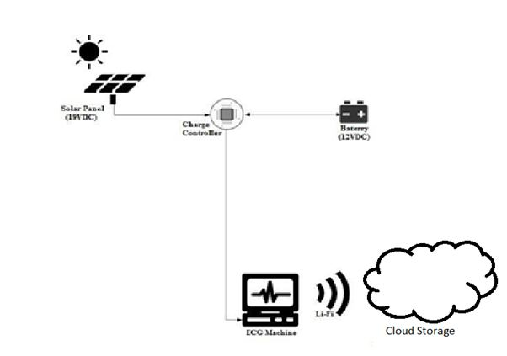
PROPOSED MODEL

Slide 5

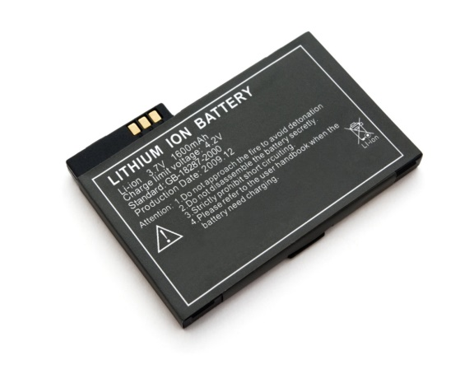
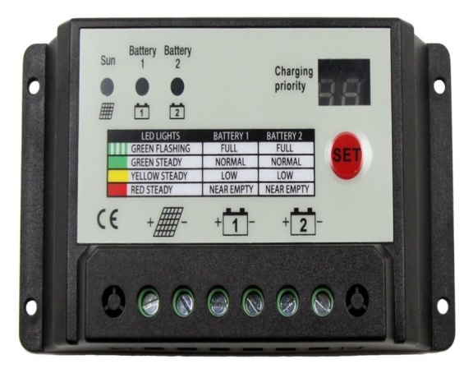
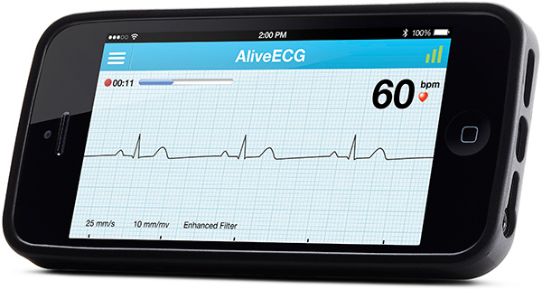
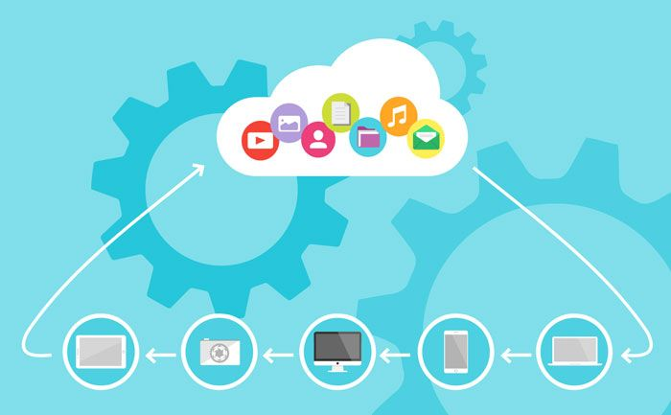
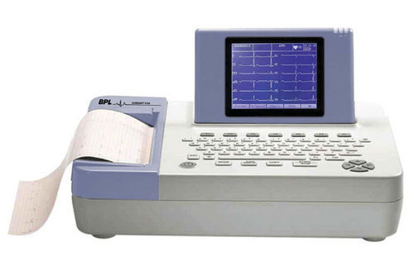
COMPONETS
SOLAR PANEL
Li-Ion BATTERY
CHARGE CONTROLLER
CLOUD STORAGE
ECG MACHINE
MOBILE APPLICATION

Slide 6
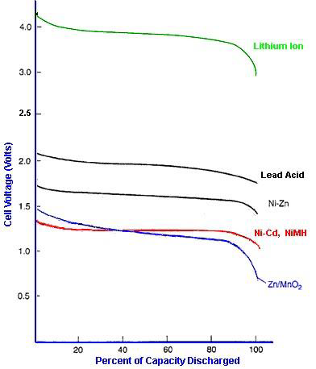
ADVANTAGES OF USING LITHIUM ION BATTERY

Slide 7
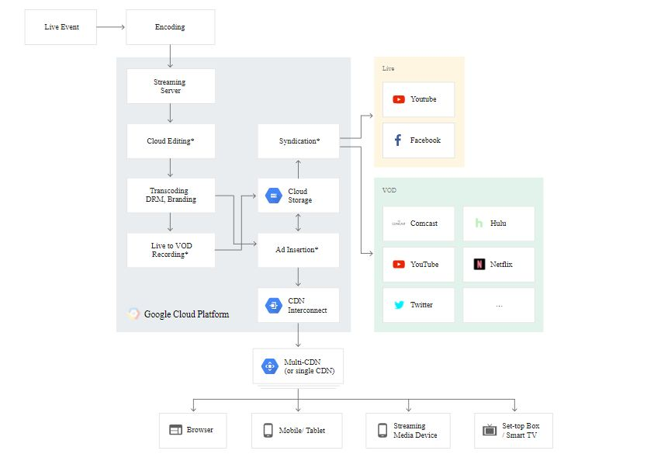
ARCHITECTURE

Slide 8

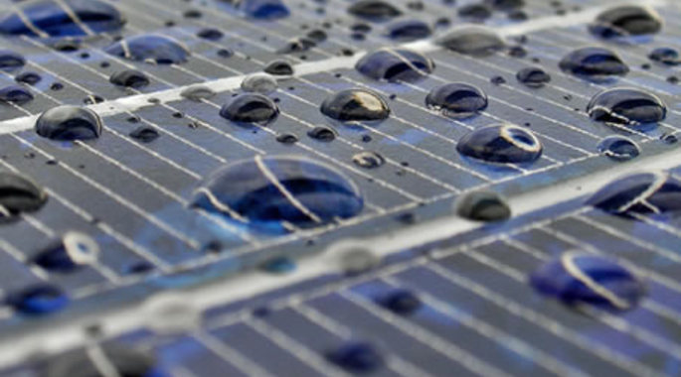

CHALLENGES

Slide 9

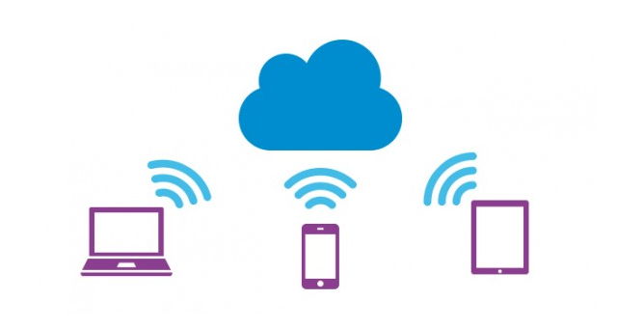
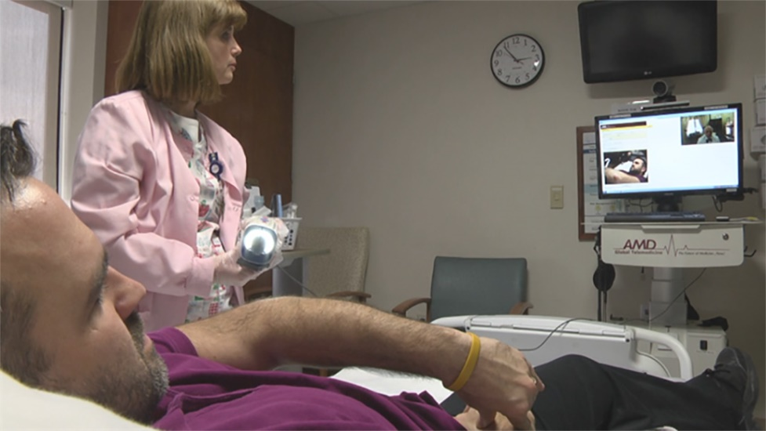
ADVANTAGES

Slide 10
CONCLUSION
The proposed device shall set a new benchmark in the field of medical science
as it tries to overcome the challenges faced by the present ECG devices.
People from all sectors, all aspects of life, and all economic background are facing heart
related issues, this machine will be a boom in rural as well as disaster prone areas.
The device shall be portable and can be carried by mobile medical vans which can
diagnose in remote areas. This Solar ECG along with EDR technology reduces
paper work of patients as it makes more people rely and dependant on technology.
This machine will serve the needs of doctors and also reduces their stress as the
application/software for display devices will act as an interface between the patient
and the doctor. Especially in third world countries this ECG device will be of
immense help to people.

